Slide 1


MAGIC CODE INSTITUTE
PYTHON
Lecture 6: Modeling Libraries in Python

Slide 2
MAGIC CODE INSTITUTE
Section 6.1 Interfacing Between pandas
and Model Code

Slide 3



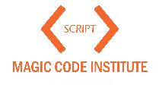
6.1 Interfacing Between pandas and Model Code

Slide 4
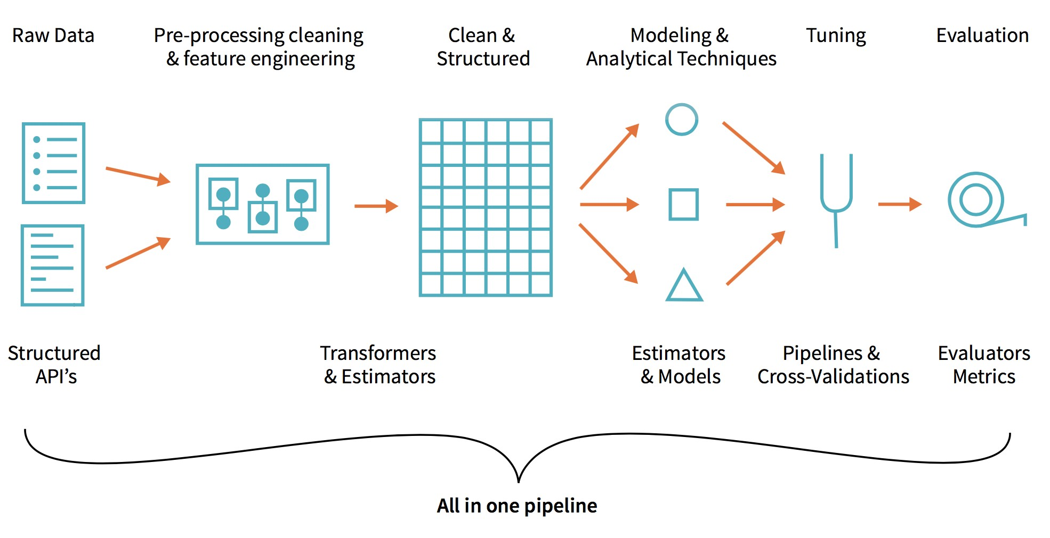
6.1 Interfacing Between pandas and Model Code
Progress of a data science project:

Slide 5

6.1 Interfacing Between pandas and Model Code
6.1 Interfacing Between pandas and Model Code

Slide 6
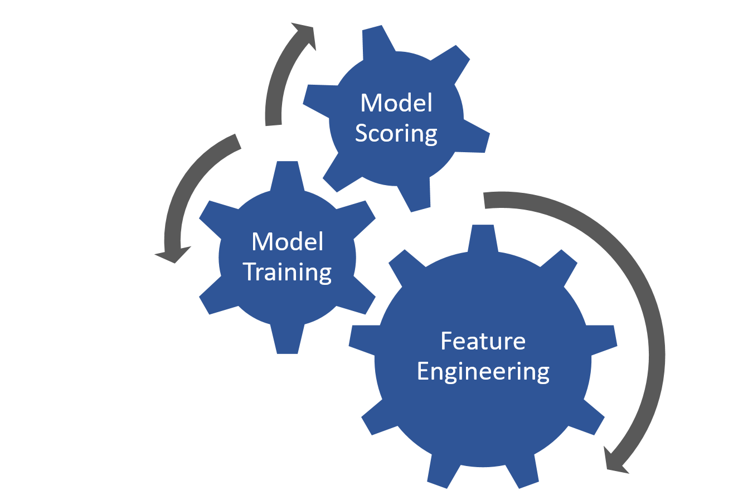
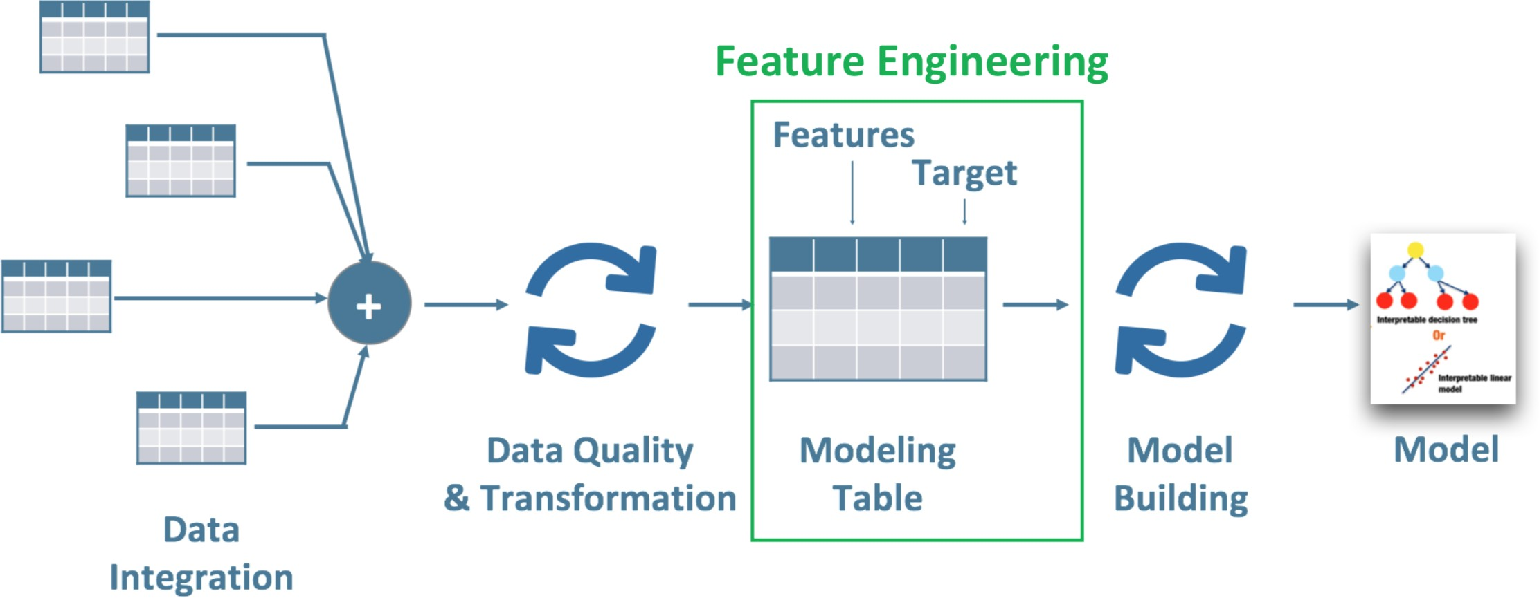
Why Feature Engineering is important:
6.1 Interfacing Between pandas and Model Code
6.1 Interfacing Between pandas and Model Code
Data is initially in a raw form and not ready for analyzing /
modeling purposes
Feature engineering is the process of using domain knowledge of the data to create (hopefully) features
Account for 80% - 90% of a data science project
➢
The data is initially in a raw form:

Slide 7

What is Feature Engineering?
6.1 Interfacing Between pandas and Model Code
6.1 Interfacing Between pandas and Model Code
Even the raw dataset has features. Most of the time, the data will be in the form of a table.
Each column is a feature. But these features may not produce the best results from the algorithm.
Modifying, deleting and combining these features results in a new set that is more adept at training the algorithm.
Feature engineering in machine learning is more than selecting the
appropriate features and transforming them.
Not only does feature engineering prepare the dataset to be compatible with the algorithm, but it also improves the performance of the machine learning models.

Slide 8
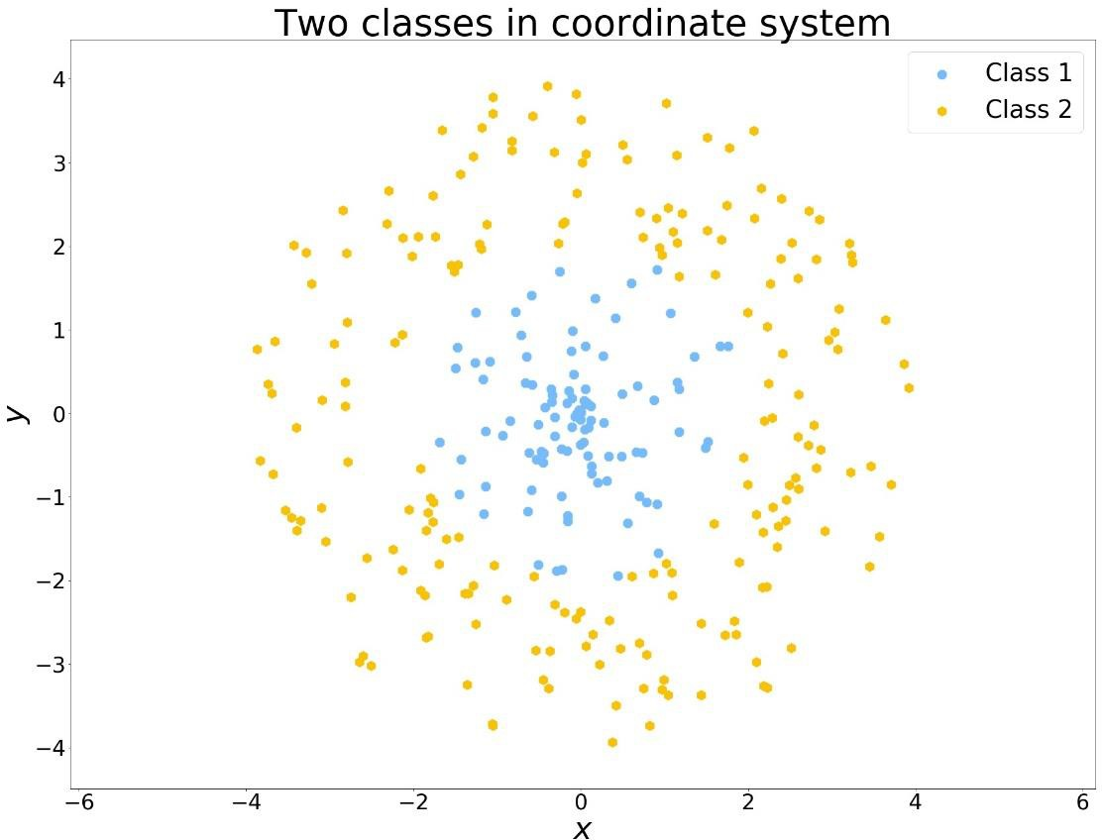
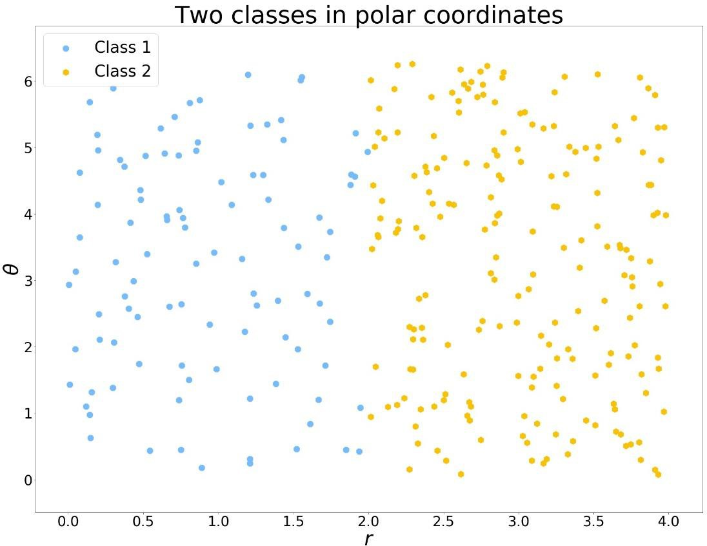
Example for the importance of Feature Engineering
6.1 Interfacing Between pandas and Model Code
6.1 Interfacing Between pandas and Model Code
Original Data: non-linear boundary and not convenient for many machine learning algorithms
Derived Data: linear boundary and will work with almost all machine learning algorithms

Slide 9
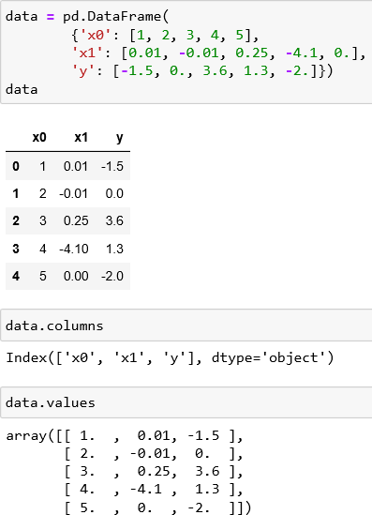
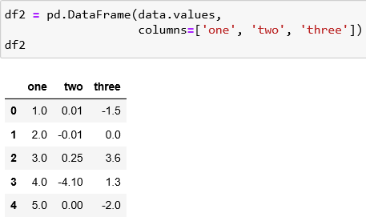
A common workflow for model development:
use pandas for data loading and cleaning.
a modeling library to build the model.
The point of contact between pandas & other analysis libraries:
NumPy arrays
To turn a DataFrame into a NumPy array:
Use the .values property:
To convert back to a DataFrame:
pass a two-dimensional ndarray with optional column names
6.1 Interfacing Between pandas and Model Code
6.1 Interfacing Between pandas and Model Code

Slide 10
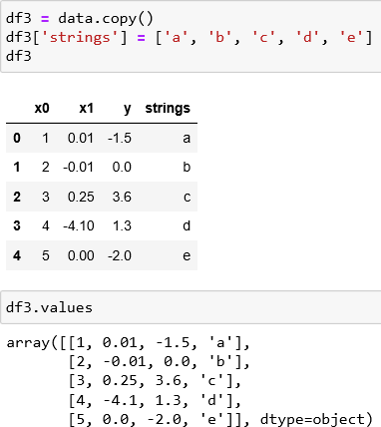
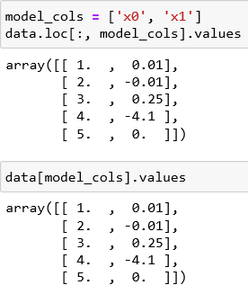
Note:
The .values attribute is intended to be used when your data is homogeneous -
for example, all numeric types.
If you have heterogeneous data, the result will be an ndarray of Python objects.
If you want to use a subset of the column
6.1 Interfacing Between pandas and Model Code
6.1 Interfacing Between pandas and Model Code

Slide 11
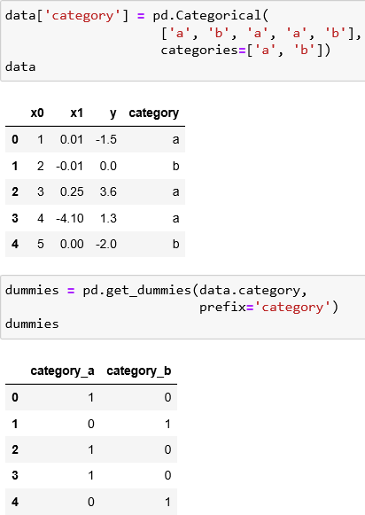
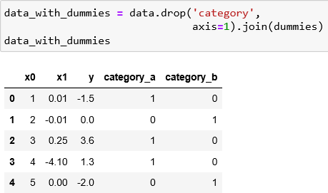
Dealing with Categorical data
6.1 Interfacing Between pandas and Model Code
6.1 Interfacing Between pandas and Model Code
If we wanted to replace the 'category' column with dummy variables:
create dummy variables
drop the 'category' column
join the result

Slide 12

MAGIC CODE INSTITUTE
Section 6.2 Creating Model Descriptions
with Patsy

Slide 13
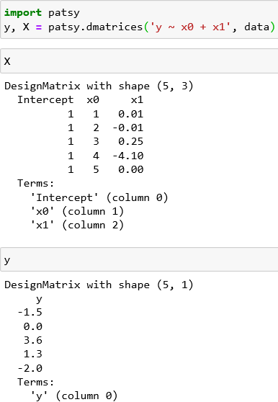
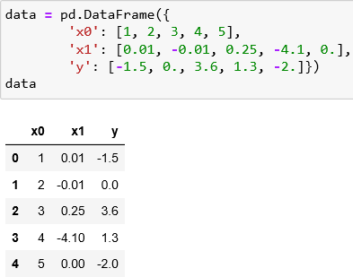
Patsy:
A Python library for describing statistical models (especially linear models) with a small string-based “formula syntax”.
well supported for specifying linear models in
statsmodels
“y ~ x0 + x1”
patsy.dmatrices function takes a formula string along with a dataset (a DataFrame or a dict of arrays) and produces design matrices for a linear model
6.2 Creating Model Descriptions with Patsy

Slide 14
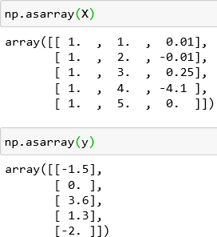
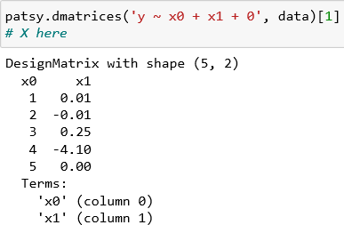
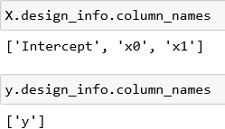
These Patsy DesignMatrix instances are NumPy ndarrays with additional metadata
The Intercept term is a convention for linear models like ordinary least squares (OLS) regression.
You can suppress the intercept by adding the term
“+ 0” to the model
6.2 Creating Model Descriptions with Patsy
6.2 Creating Model Descriptions with Patsy

Slide 15
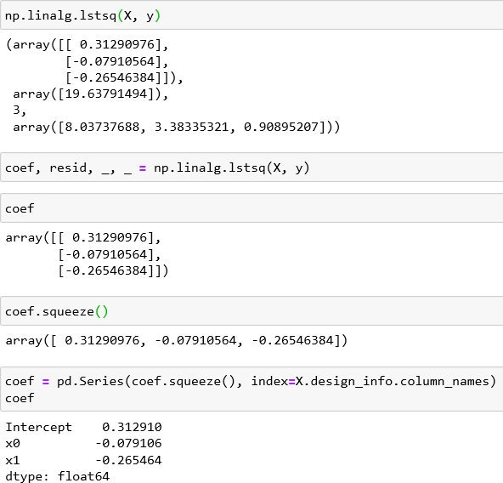
6.2 Creating Model Descriptions with Patsy
The Patsy objects can be passed directly into algorithms
6.2 Creating Model Descriptions with Patsy
Get model coefficients
Reattach the model column names to the fitted coefficients to obtain a Series

Slide 16
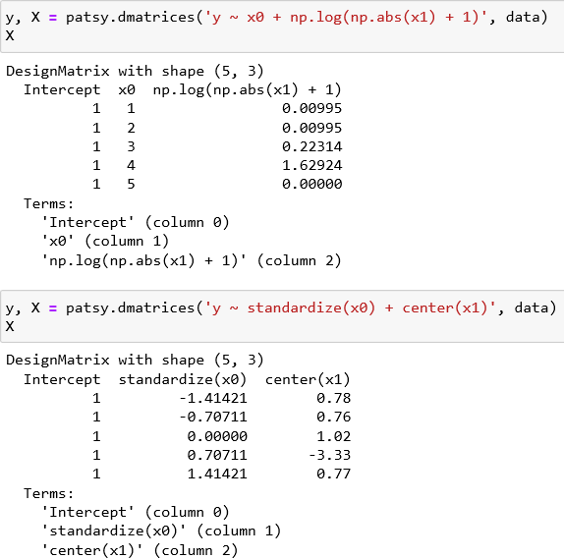
6.2 Creating Model Descriptions with Patsy
6.2 Creating Model Descriptions with Patsy
Data Transformations in Patsy Formulas
Patsy will try to find the functions you use in the enclosing scope
Some commonly used variable transformations include:
Standardizing (to mean 0
and variance 1):
Centering (subtracting the mean).

Slide 17
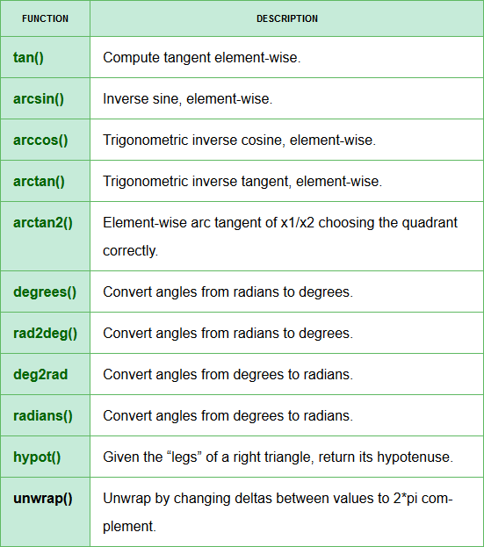
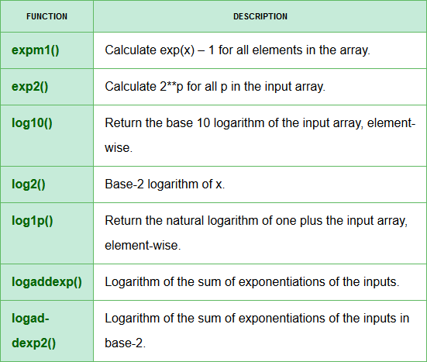
6.2 Creating Model Descriptions with Patsy
6.2 Creating Model Descriptions with Patsy
Try some other numpy functions

Slide 18
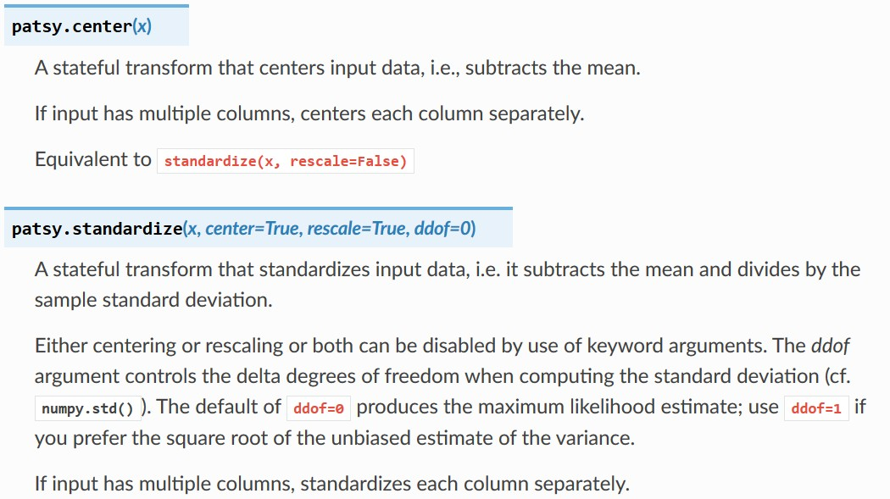
6.2 Creating Model Descriptions with Patsy
6.2 Creating Model Descriptions with Patsy

Slide 19
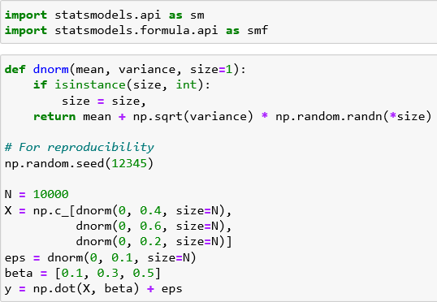
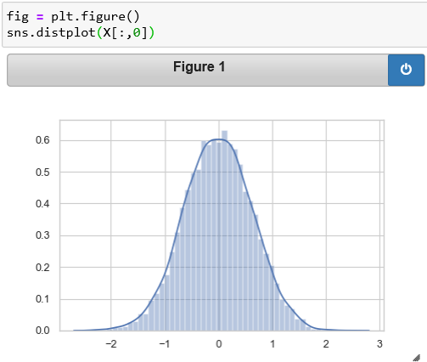
Import modules
dnorm: helper function to generate random numbers following normal distribution
Y is constructed as:
o Y = X * beta + eps (noise)
6.3 Introduction to statsmodels
Normally distributed with:
mean = 0
Variance = 0.4

Slide 20
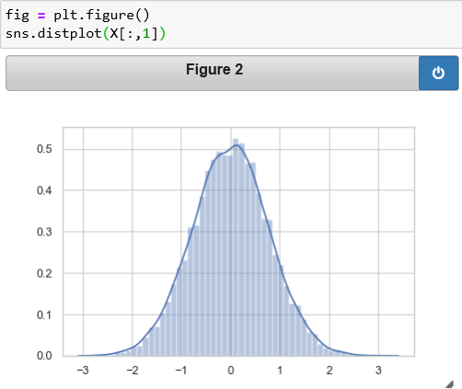
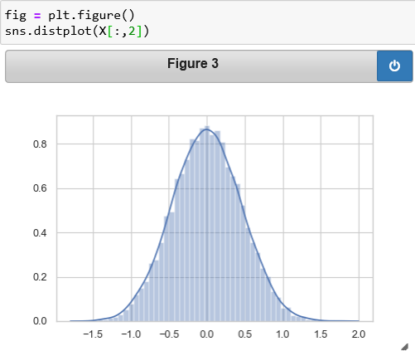
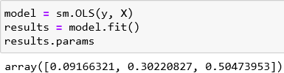
Normally distributed with:
mean = 0
Variance = 0.6 (0.2)
6.3 Introduction to statsmodels
6.3 Introduction to statsmodels

Slide 21
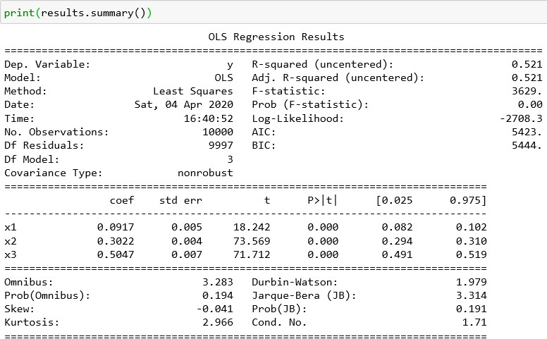
6.3 Introduction to statsmodels
6.3 Introduction to statsmodels

Slide 22
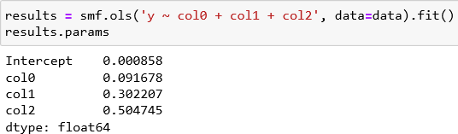
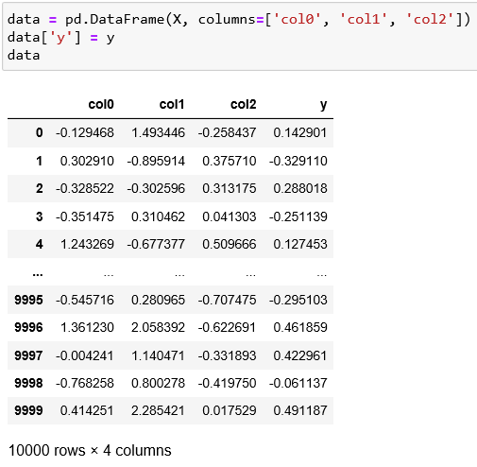
6.3 Introduction to statsmodels
6.3 Introduction to statsmodels

Slide 23
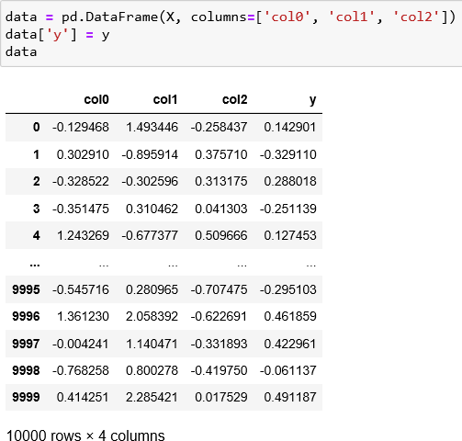
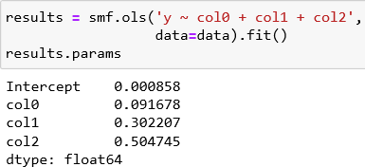
6.3 Introduction to statsmodels
6.3 Introduction to statsmodels
Suppose instead that all of the model parameters are in a DataFrame
use the statsmodels formula API
and Patsy formula strings

Slide 24

MAGIC CODE INSTITUTE
THANKS FOR LISTENING!!!

Slide 25
